Slide 1
STORAGE CLASSES
C Storage classes provide the following information to the compiler
Storage area of a variable.
Scope of variable i.e. in which block the variable is visible.
The lifetime of a variable i.e. how long the variable will be there in active mode.
The default value of a variable if it is not initialized.
Types of storage classes
Automatic storage class
Static storage class
Further automatic and static storage classes devided into two types those are given below

Slide 2
Flow digram:
STORAGE CLASS
AUTOMATIC
STATIC
auto
register
static
extern

Slide 3
1.Automatic storage class
This storage class variables will be created automatically and destroyed automatically.
Automatic storage class variables will be store in the stack area of the data segment or in the CPU register.
Under automatic storage class, we have two types of storage class specifiers
a) Auto
b) register
2.Static storage class
Static storage class variables will be created only once and throughout the program,it will be there in active mode.
Static storage class variables will be there in the static area of the data segment.
Under static storage class, we have two types of storage class specifiers
a) static
b) extern

Slide 4
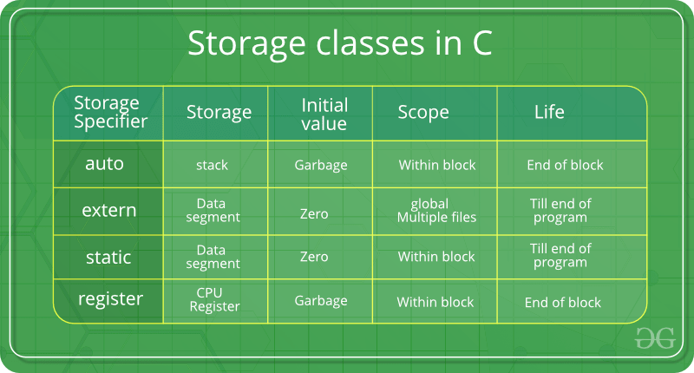
Storage classes in C:
draw with hand
order:
1.auto
2.registor
3.static
4.extern

Slide 5
1.auto storage class
It is the default storage class for all local variable .
Ex : print a value
#include <stdio.h>
void abc( ); //function declaration
int main( ){
abc( ); //function call
abc( );
abc( );
return 0; //to execute with 0 error purpose we use
}
void abc( ) //without return and without argument type function
{
auto int a = 5; //read a as new every time of function call
a++;
printf("a = %d\n", a);
}
Output :
a = 6
a = 6
a = 6

Slide 6
4.register storage class:
It is a special kind of variable that stores in the CPU register.
The advantages of register variables are faster than the remaining variables.
The register storage class is used to define local variables that should be stored in a register instead of RAM.
This means that the variable has a maximum size equal to the register size (usually one word) .
Can’t have the unary ‘&’ operator applied to it (as it does not have a memory location).
In scanf() function if the address is provided for the register variable then it will give an error, if the address is not provided then it works normally.
register storage class specifier first recommended to the compiler to hold the variable in CPU register if the memory is available or else store in stack area of the data segment.

Slide 7
Example:
#include <stdio.h>
int main()
{
register int a = 10;
++a;
printf("Value of a : %d", a);
printf("\nEnter a value :");
scanf("%d" , a); //here & not used .if used it will give an error
a--;
printf("\n Value of a : %d", a);
return 0;
}
Output:
a = 11
enter a value : 30
not print value

Slide 8
2.static storage class:
When we are working with the auto variables, scope, and lifetime both are restricted with the body. But when we are working with static variables, the scope is restricted is within the function but the lifetime is not restricted.
Ex : print a value
#include <stdio.h>
void abc( ); //function declaration
int main( )
{
abc( ); //function call
abc( );
abc( );
return 0;
}
void abc( ) //without return and without argument type function
{
static int a = 5; //a is updated value every time of function call
a++;
printf("a = %d\n", a);
}
Output:
a = 6
a = 7
a = 8

Slide 9
3.Extern storage class
The variable which is created by using the keyword extern called as extern variable.
In implementation when we need to access a variable in more than one function then go for extern variables i.e global variables are required.
When we are working with global variables scope and lifetime both are not restricted.
The extern modifier is most commonly used when there are two or more files sharing the same global variables or functions

Slide 10
Example:
#include<stdio.h>
extern int a =5; //this ‘a’ is available entire program
int main( )
{
int a = 3; // this ‘a' is valid only in main
printf ("a = %d\t",a);
fun ( );
}
fun( )
{
printf ("a = %d", a);
}
Output:
a = 3
a = 5

